Slide 1

Earthquakes Data Analytics Portal Big Data Applications
London, February 2020

Slide 2
Part A
Hive ETL pipeline
and big data analytics

Slide 3
ETL pipeline with Hive
ETL (Extract - Transform - Load)
Data sources:
Earthquakes information
USGS – US Geological Survey: https://earthquake.usgs.gov
Format: csv
Rest API: https://earthquake.usgs.gov/fdsnws/event/1/[METHOD[?PARAMETERS]]
World cities information https://simplemaps.com Format: csv
Seismograph Stations: Federation Digital Seismgraph Network http://www.fdsn.org/networks/detail/IU

Slide 4
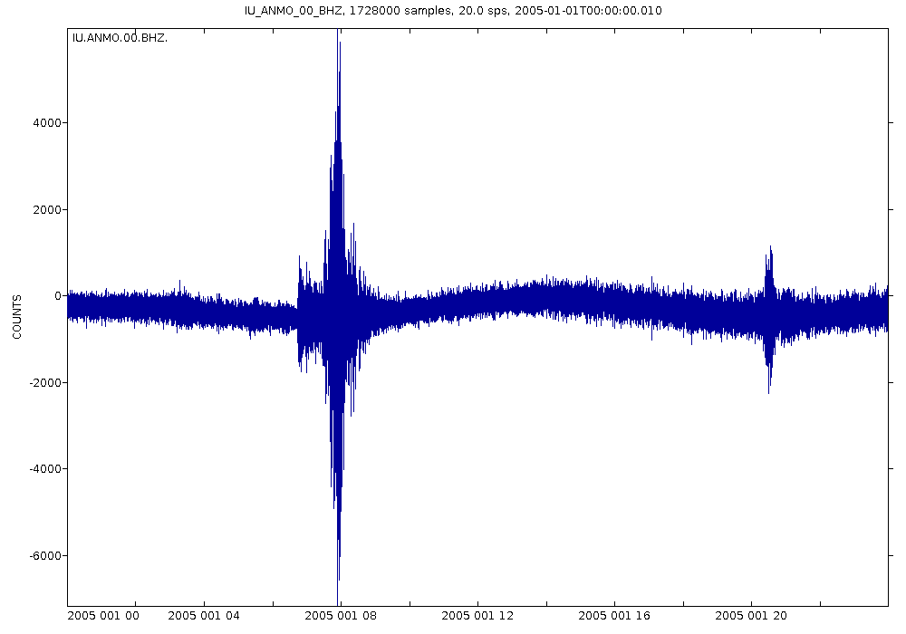
ETL pipeline with Hive
Problem statement
The three datasets contain information potentially related to earthquakes.
However, with the current structure we are not able to answer questions like:
Which city is closest to an earthquake?
How many people might be affected by an earthquake?
How can we reproduce the seismograph wave of a specific earthquake?
Which seismograph station has the biggest earthquake?
Etc..
Seismograph Wave
The Seismograph waves are available at the URL:
http://service.iris.edu/irisws/timeseries/1
Sample link:
http://service.iris.edu/irisws/timeseries/1/query?net=IU&sta=ANMO&loc=00&cha=BHZ&starttime=2005-01-01T00:00:00&endtime=2005-01-02T00:00:00&output=plot

Slide 5
ETL pipeline with Hive
Solution
To be able to answer questions similar to the previous ones, we need to apply an ETL process which at the end will combine the three datasets into one Hive table.
The final table will contain information for every earthquake accompanied by the closest city and closest seismograph station.
At this phase, we will be able to produce links to seismograph waves and answer several research questions.

Slide 6
ETL pipeline with Hive
Phase 1
Phase 2
Phase 3
Phase 4
Acquisition
Preparation
Load to
filesystem
Database
preparation
ETL process
4.1
Load earthquakes dataset
Earthquakes
Extract earthquakes required columns
4.2
Join table from 4.2 with cities table and calculate distances to all cities
Cities
Hive client
4.3
Use table from 4.3 and create a table with distinct earthquakes and closest city
Create database
Load cities and
seismograph
stations to Hive
4.4
Seismographic
Stations
Join table from 4.4 with stations table and calculate distances to all stations
4.5
Further Analysis
Process
Completion
Use table from 4.5 and create a table with distinct earthquakes and closest city/station
4.6

Slide 7
Further analysis – examples People affected
Hive
SELECT id, time, day, magnitude, country,
city, population, city_distance
FROM earthquakes_distance_to_all_cities
WHERE
id='us10007sd4’
AND population is NOT NULL
ORDER BY city_distance;
Took 10 minutes to run
in a VM with 8 cores and 16GB of RAM

Slide 8
Further analysis – examples Earthquakes per month
Spark version 1 - example with RDDs (resilient distributed dataset)
Sample map reduce job – group-by month all earthquakes of year 2019
RDDs
Results
Took seconds to run
in a VM with 8 cores and 16GB of RAM

Slide 9
Further analysis – examples Earthquakes per country
Spark version 2 - version 2
Sample spark SQL – Group-By country with Data Frames and SQL
Results
Data frames
SQL
Available only
on Spark2
Data frames are
the primary API
RDD API is
in maintenance
mode
Took seconds to run
in a VM with 8 cores and 16GB of RAM

Slide 10
Further analysis - examples
Tableau visualization
Connection to Hive

Slide 11
Hive ETL process
Advantages
Distributed computing
Scalability
Fault tolerance
Ease to use
Multiple applications
Better insights
Limitations
Only batch processing
Manual
Static data

Slide 12
Part B
Extending the application
by utilizing big data solutions

Slide 13
Required improvements
Automation
Control
Real-time data (streaming)
Advanced analytics

Slide 14
Automation
Option 1: Graphical interface to create workflows
Option 2: XML file that describes a workflow
Oozie is a workflow scheduler system
to manage Apache Hadoop jobs.
Workflow jobs are Directed Acyclic Graphs (DAGs)
of actions.
Oozie Coordinator jobs are recurrent
Oozie Workflow jobs can be triggered by
time (frequency) and data availability.

Slide 15
Real-Time Data
A distributed service for collecting,
aggregating, and moving large amounts
of streaming data into HDFS.
Flume sample configuration file
Flume uses configuration files and agents.
A configuration file contains sources, sinks and channels.
The sample figure has:
Source - log file
Sink - HDFS path
Channel – memory
A Flume agent monitors the log file for changes and uploads
those changes to HDFS

Slide 16
Real-Time Data
A high-throughput distributed messaging system.
A Kafka cluster allows multiple producer to write data to its
internal data store and the consumers read those data.
The data are being stored in the cluster for a configurable time period.
1
In each partition a producer writes new data
and a consumer reads the data (offset).
Multiple consumers have different offsets.
3
Kafka data are being written to topics.
Producers and consumers, use topics to write/read data.
Topics can be created by users and applications.
Each topics has a set of partitions and each partitions is stored in a different Kafka broker (member of the cluster).
Consumers can be assigned to consumer groups.
The groups have different offsets and the
consumers read data from a specific partitions.
2
4

Slide 17
Kafka producer – consumer (console example)
1
Create a Kafka topic.
Configure a consumer to read data
streamed to this topic.
2
3
Create a producer and write (stream) data to this topic.
4
The data are being consumed by the consumer.
5
List all consumer groups
6
Consumer group – data stored in each partition and offset status.

Slide 18
Kafka twitter producer - consumer
1
A producer that connects to twitter and streams tweets in real-time to Kafka cluster. Data format json.
Consumer group -data stored in each partition
and offset status.
3
2
A consumer that reads the tweets from the Kafka cluster, extracts data and converts them to csv format.

Slide 19
Conclusion
Hive is a powerful tools with many applications.
However, by utilizing the tools mentioned in the previous slides we can extend the potentials of an application.
In particularly, those tools empower us to have the following improvements – additions:
Automation
Real-time data
Associate earthquakes with tweets - NLP
Add more sources like RSS or web scraping
Real time and batch processing
Make predictions
and more….

Slide 20
Available Sources
Earthquakes ETL pipeline with Hive – Tutorial source:
https://github.com/UoW-CPC/rabbda-earthquakes-portal/tree/release-0.0

